Slide 1
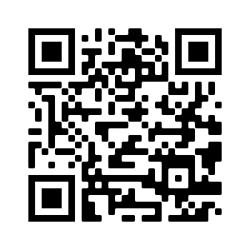
Attendance Taking
Materials:
smu.sg/ellipsis-wad-2021-materials Attendance Form: (QR Code) or
smu.sg/ellipsis-wad-2021-attendance
*Practise question solution will be emailed to participants who have submitted their attendance

Slide 2


< WAD Workshop />

Slide 3
Agenda
The Internet in a nutshell
What is PHP?
What is object-oriented programming?
Object-oriented PHP
Database Interaction with PHP

Slide 4







The Internet
Hostname
IP address
Database
URL
DNS Server
HTTP request
Web
Browser
HTTP response
Processing Engines
Web Server
Resources
‹#›
Notes:
Purpose of DNS Server – it will help to convert web URL (domain name) to an IP address. When someone enter e.g www.ellipsis.com.sg it will help to return an IP address 10.10.10.10
After rendering the IP address, user can send an HTTP/HTTPS request to Web Server (It will help to render HTML, CSS, JS) – interact with database and resources

Slide 5
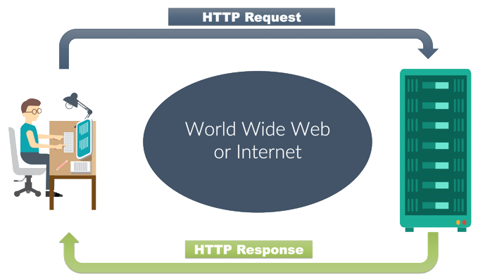

The Internet in a nutshell
HTTP Request
> GET / HTTP/1.1
> Host: www.google.com
> User-Agent: curl/7.60.0
> Accept: */*
> Cookie:
> Host:
You
Server
HTTP Response
Notes:
Request GET/POST – Transfer data to client server
GET – information will be appended at the back of the URL. E.g /test/demo_form.php?name1=value1&name2=value2
POST – information will not be shown at the URL - secure

Slide 6
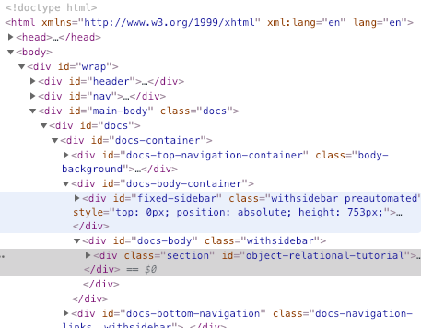
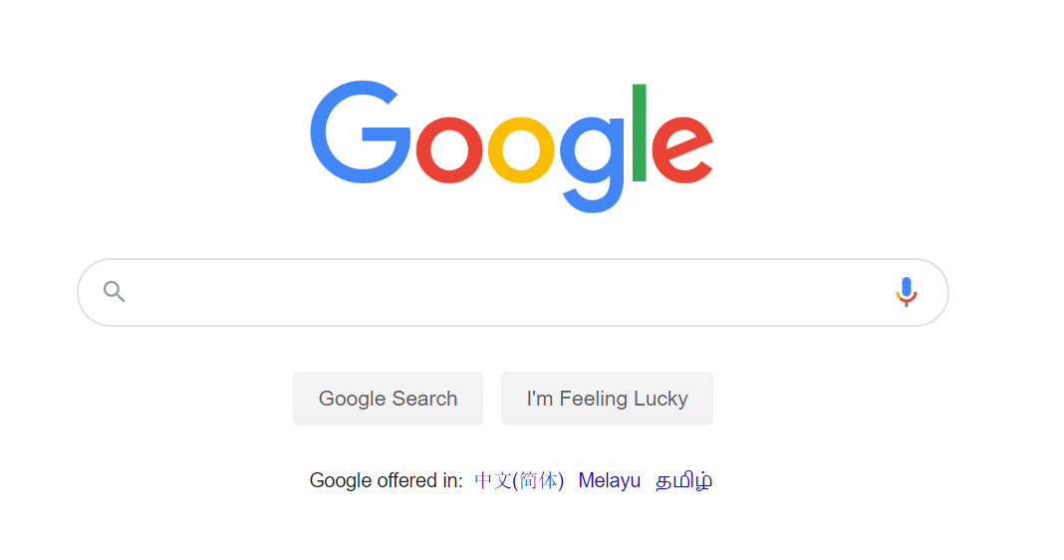

The Internet in a nutshell
GET http://www.animals.com/dog.html
HTTP RESPONSE
< HTTP/1.1 200 OK
< Date: Tue, 29 Jan 2019 15:48:40 GMT
< Server: Apache/2.2.34 (Unix) mod_wsgi/3.5 Python/2.7.13 PHP/7.1.19 mod_ssl/2.2.34 OpenSSL/1.0.2o DAV/2 mod_fastcgi/mod_fastcgi-SNAP-0910052141 mod_perl/2.0.9 Perl/v5.24.0
< Last-Modified: Tue, 29 Jan 2019 15:43:44 GMT
< ETag: "44a049-28-5809aa8828c00"
< Accept-Ranges: bytes
< Content-Length: 40
< Content-Type: text/html
<
<HTML>
You
Server
HTTP Response
Notes:
Status code
1xx: Informational
2xx: Success – Successfully locate the page and sending it to the browser
3xx: Redirection
4xx: Client error – cannot find the page
5xx: Server error – Server is down

Slide 7






Server side & Client side rendering
HTTP Request
You
Server
HTTP Response
Notes:
Interact with database via SQL queries
Interact with processing engines and resources
Response – return HTML and other files as an HTTP response message
Browser will process the response message and renders it into a nice, looking message that is display on your terminal

Slide 8

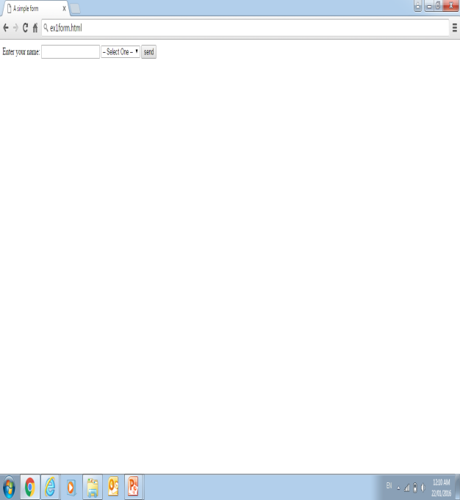
How Wamp works
Request page
Run Script
Request
data
Web Browser
Send
data
Send
data
Webserver
PHP
Engine
Database
Send HTML
output
Notes:
WAMP
W – windows (Operating System)
A – Apache (Web Server)
M – MySQL (Database)
P – PHP (Web Scripting Language)

Slide 9

<?PHP
PHP is a general-purpose scripting language that is especially suited to server-side web development, in which case PHP generally runs on a web server.
- Wikipedia

Slide 10
<?PHP Syntax
Notes:
As compared to python, since students took IS111 Introduction to programming, we will try to link the syntax to python to give them a better idea.

Slide 11

Hello World!
<?php
echo "$message!!!";
?>
print(f'{message}!!!’)

Slide 12
Data Types
<?php
Variable Symbol: $
Naming Convention:
?>
First Character | Only Contain | Cannot Contain
Letter or _ | Alpha-numeric characters and underscores (a-z, A-Z, 0-9, and _) | Spaces
Separate words with an underscore ($trans_date) or with capitalization ($transDate)
Notes:
Things to take note
Python is float – php is double
Boolean – uppercase (php), lowercase (python)

Slide 13
Data Types
<?php
$string = 'hello world’
$int = 1
$double = 3.14
$bool = TRUE/true
string = 'hello world'
int = 1
float = 3.14
bool = True
Notes:
Things to take note
Python is float – php is double
Boolean – uppercase (php), lowercase (python)

Slide 14
String - Concatenation
<?php
Concatenate two strings:
echo “String 1 and ” . “String 2”;
Concatenate a variable and a string:
echo “String 1 ” . $module;
Concatenate two strings:
echo “String 1 and ” + “String 2”;
Notes:
Things to take note
Python is float – php is double
Boolean – uppercase (php), lowercase (python)

Slide 15
Data Structures
Arrays and Associative array
<?php
$array = [1, 2, 3];
$assoc_array = [
"key1" => "value1",
"key2" => "value2"
];
list = [1, 2, 3]
dictionary = {
'key1': 'value1',
'key2': 'value2'
}
Notes:
Take note of the assignment of the key to value syntax for associative array

Slide 16
If Statements
<?php
if ($x == 1 && $y == 2) {
echo "I love apple";
} elseif ($x == 2) {
echo "I love orange";
} else {
echo "I love mango";
}
if x == 1 and y == 2:
print('I love apple')
elif x == 2:
print('I love orange')
else:
print('I love mango')

Slide 17
For Loops
<?php
for ($i = 0; $i < 10; $i++) {
echo "$i <br>";
}
$array = ["hello", "world", "!"];
foreach ($array as $string) {
echo "$string <br>";
}
for i in range(10):
print(i)
mylist = ['hello', 'world', '!']
for string in mylist:
print(string)
Notes:
Take note of the closing and opening bracket

Slide 18
For Loops
<?php
$array = [
"key1" => "value1",
"key2" => "value2",
"key3" => "value3"
];
foreach ($array as $key => $value) {
echo "$key and $value";
}
dic = {
'key1': 'value1',
'key2': 'value2',
'key3': 'value3'
}
for key, value in dic.items():
print(key, value)
Notes:
Take note of the for each syntax (using of as $key => $value)
if $key is not stated in the foreach loop, ONLY value will be echoed

Slide 19
While Loops
<?php
$i = 0;
while ($i < 10) {
// ...
$i++; $i += 1;
}
i = 0
while i < 10:
# ...
i += 1
Notes:
both ways for increment

Slide 20
Functions
<?php
function sayLoudly($message) {
echo "$message!!!";
}
def say_loudly(message):
print(f'{message}!!!')

Slide 21

Try it out {
$questions = [1, 2, 3, 4, 5, 6];
}

Slide 22

Forms

Slide 23


Form
$_POST and $_GET are superglobal variables meant to collect data from forms, it is defined in PHP form attribute
POST method is generally deemed more secure, it’s better to choose it for sensitive data
GET method can’t provide such security, but allows you to bookmark certain pages
Notes:
POST method is generally deemed more secure, so it's better to choose it for sensitive data.
GET method can't provide such safety, but allows you to bookmark certain pages.
$_POST and $_GET are superglobal variables meant to collect data from forms. Its destination is defined in PHP form action attribute.

Slide 24
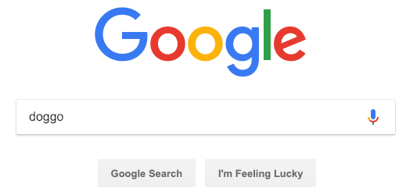


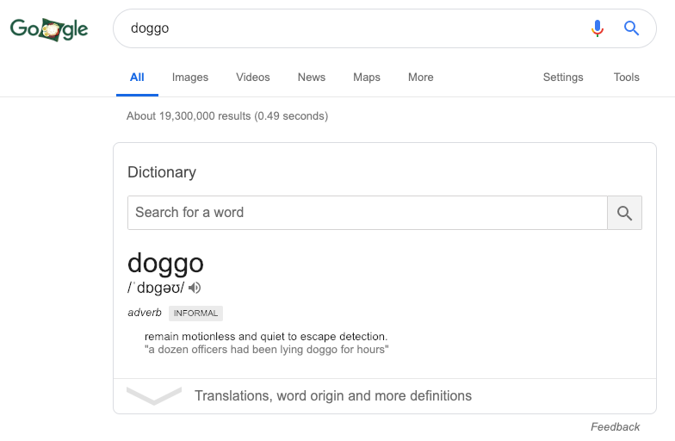
Forms (Template for user requests)
Common process when visiting sites
Visit web page → login? → search for stuff → etc.
search="doggo"
Notes:
The HTML <form> element defines a form that is used to collect user input.
This user input will be sent to the server, which can then be processed, then sending the appropriate output/response back to the user.
E.g. I search for dog →

Slide 25

Forms: Example
User input entered here will be put into a request, then sent to the server upon hitting the Sign In button.

Slide 26

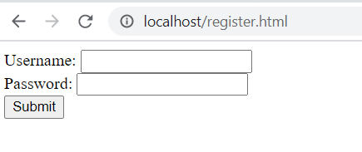
Creating a Form
/register.html
Create a file named login.php in your web folder
Accessing localhost/register.html with your browser, it should look similar to this
<form action="authenticate.php">
Username: <input type="text" name="username">
Password: <input type="password" name="password">
<input type="submit">
</form>
www
register.html

Slide 27
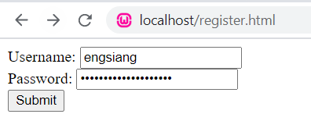
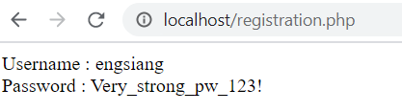
Creating a Form
/registration.php
<?php
$username = $_GET['username'];
$password = $_GET['password'];
echo "username: $username <br> password: $password";
?>
Create a file named authenticate.php in your web folder.
www
register.html
registration.php
login.php
GET
authenticate.php

Slide 28
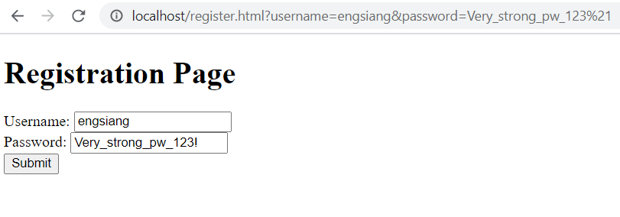
Sending confidential info via GET?

Slide 29
A POST Form
/register.html
<form action="authenticate.php" method="POST">
Username: <input type="text" name="username">
Password: <input type="password" name="password">
<input type="submit">
</form>
Modify register.html’s form to use ‘POST’ instead of the default ‘GET’.
Accessing localhost/register.html with your browser, it should look similar to this

Slide 30
A POST Form
/registration.php
<?php
$username = $_POST["username"];
$password = $_POST["password"];
echo "username: $username <br> password: $password";
?>
Modify authenticate.php to retrieve the values from the $_POST array, another superglobal.
register.html
POST
Note that the URL no longer contains the user’s login credentials.
registration.php

Slide 31
Superglobals
accessible, regardless of scope.
can access them from any function, class or file without having to do anything special.
$_GET
$_POST
vs
$_SESSION
Notes:
Cover $_Request

Slide 32
Try it out {
$questions = [7, 8, 9, 10];
}
Notes:
More info on preg_match: https://www.guru99.com/php-regular-expressions.html

Slide 33
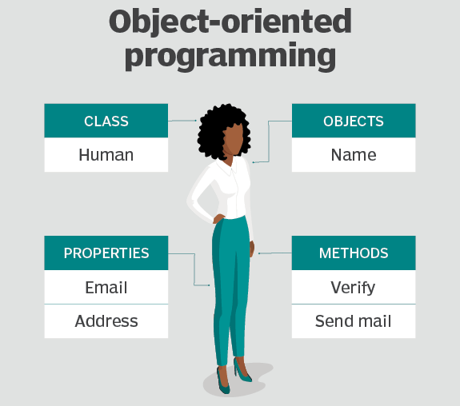
Object-oriented programming
Notes:
Encapsulation is one of the fundamental concepts in object-oriented programming (OOP). It describes the idea of bundling data and methods that work on that data within one unit
Make related function & variables into the same class to make it more structured
More structured → More reusable
Developer can find the code and debug better if things are organized together in a file
Classes are usually stored in different files and used by importing it over to the main file
https://www.researchgate.net/post/What_is_adventages_of_Object_Oriented_Programming

Slide 34

Object-oriented Programming
How would you represent Bob in a computer application?
Hair: Brown
Has a beard
Machine: Macbook
Alcoholic
Fly: undone
Fashion: Old
Notes:
Programming can be thought of as instructing the computer to perform tasks.
To perform any task -- in the physical or digital world -- data will be manipulated.
When we write computer applications, we are almost always dealing with data.
Take a look at bob. You’re tasked with performing some analysis on Bob, and need to capture + process / analyse certain pieces of data relating to his characteristics.

Slide 35
Object-oriented Programming
person_name = "Bob"
person_hair = "brown"
person_machine = "macbook"
person_has_beard = True
person_is_alcoholic = True
person_fashion = "old”
Notes:
Bob’s data
Explain how we store variables into an objects? Will show how to create a class and an object?
Useful extension: PHP intellisense

Slide 36
Classes & Objects
Create class
Define attributes
Define methods
Create object (instance of a class)
Define a constructor – variable require for the object
Use the object for any type of manipulation

Slide 37
Object-oriented PHP
Person.php
Create class
<?php
class Person {
private $name;
private $hair;
private $machine;
private $has_beard;
private $is_alcoholic;
private $fashion;
public function __construct ($name, $hair, … ){
$this->name = $name;
$this->hair = $hair;
…
}
} ?>
1
1
class keyword, followed by name of the class
2
2
Declare attributes
3
Write constructor
3
Notes:
Default – public
Public – This level had no restriction it can be called in any scop. A public property of an object can be both retrieved and modified from anywhere in a program – in the class, a subclass, or from outside of the class.
Private – Scope when the property and method can only be visible on its own class only.
In this case, all the variable can only be access in the class.
The constructor being a public function can be access by other classes

Slide 38
Object-oriented PHP
2. Create object
Use the new keyword to construct new objects
main.php
<?php
require_once ’Person.php';
$bob = new Person ('Bob', 'brown', 'macbook', True, True, 'old’);
?>
Notes:
Constructing a new object – the data that is assign to the parameters of the object

Slide 39
Object-oriented PHP
Person.php
3. Use object for whatever
class Person {
private $name;
private $hair;
...
public function __construct ($name, $hair, ...){
$this->name = $name;
$this->hair = $hair;
...
}
public function getName(){
return $this->name;
}
public function setName($newName){
$this->name = $newName;
} }
Getters: To access and read private properties
Setters: To access and modify private properties

Slide 40
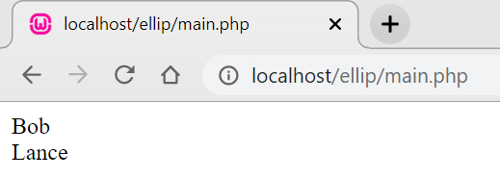
Object-oriented PHP
main.php
3. Use object for whatever
require_once 'Person.php';
$bob = new Person ('Bob', 'brown', 'macbook', True, True, 'old');
$myName = $bob->getName();
echo $myName;
echo "<br>"; $bob->setName('Lance’);
$bobName = $bob->getName();
echo $bobName;
Getters: To access and read private properties
Setters: To access and modify private properties

Slide 41
Object-oriented PHP
3. Use object for whatever
$person = new Person(‘Ernest', 'brown', 'macbook', ...);
if ($person->getName() == ‘Jack') { ... }

Slide 42
Try it out {
$questions = [11, 12, 13*];
}

Slide 43
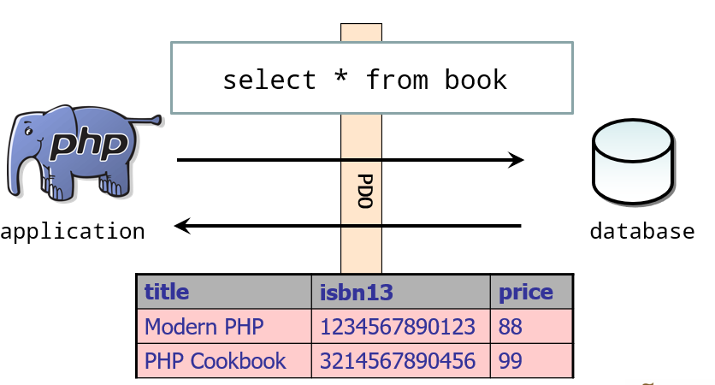
Database Interaction
Notes:
Encapsulation is one of the fundamental concepts in object-oriented programming (OOP). It describes the idea of bundling data and methods that work on that data within one unit
Make related function & variables into the same class to make it more structured
More structured → More reusable
Developer can find the code and debug better if things are organized together in a file
Classes are usually stored in different files and used by importing it over to the main file
https://www.researchgate.net/post/What_is_adventages_of_Object_Oriented_Programming

Slide 44
Database Interaction with PHP
Connect to Database
Prepare statement object
Specify return data format
Prepare SQL statement
Run SQL statement
Retrieve results
Free up resources

Slide 45
Basic Syntax
$dsn = "mysql:host=localhost;dbname=book;port=3306";
$pdo = new PDO($dsn, “root", "");
$isbn13= ‘1234567890123'; // simulates a user input $sql = 'select * from book where isbn13 = :isbn13';
$stmt = $pdo->prepare($sql); //PDOStatement
$stmt->setFetchMode(PDO::FETCH_ASSOC);
$stmt->bindParam(‘:isbn13', $isbn13, PDO::PARAM_STR);
$stmt->execute();
while($row = $stmt->fetch()) {
echo $row['title'] . '|' . $row['isbn13’] . '|' . $row['price'];
}
$stmt->closeCursor();
$pdo = null;

Slide 46
Basic Syntax
$dsn = "mysql:host=localhost;dbname=book;port=3306";
$pdo = new PDO($dsn, “root", "");
$isbn13= ‘1234567890123'; // simulates a user input $sql = 'select * from book where isbn13 = :isbn13';
$stmt = $pdo->prepare($sql); //PDOStatement
$stmt->setFetchMode(PDO::FETCH_ASSOC);
$stmt->bindParam(‘:isbn13', $isbn13, PDO::PARAM_STR);
$stmt->execute();
while($row = $stmt->fetch()) {
echo $row['title'] . '|' . $row['isbn13’] . '|' . $row['price'];
}
$stmt->closeCursor();
$pdo = null;
Step 1: Connect to Database
$dsn : Connection String
host : hostname dbname: database name
port : port number
$pdo : PHP Data Object
PDO(Connection String, username , password)
Notes:
In this case, we are connection to a localhost database hosted on port 3306, with the schema name “book”

Slide 47
Basic Syntax
$dsn = "mysql:host=localhost;dbname=book;port=3306";
$pdo = new PDO($dsn, “root", "");
$isbn13= ‘1234567890123'; // simulates a user input $sql = 'select * from book where isbn13 = :isbn13';
$stmt = $pdo->prepare($sql); //PDOStatement
$stmt->setFetchMode(PDO::FETCH_ASSOC);
$stmt->bindParam(‘:isbn13', $isbn13, PDO::PARAM_STR);
$stmt->execute();
while($row = $stmt->fetch()) {
echo $row['title'] . '|' . $row['isbn13’] . '|' . $row['price'];
}
$stmt->closeCursor();
$pdo = null;
Step 2: Prepare statement object
$sql : SQL Statement
$pdo->prepare : Prepares a statement for execution and returns a statement object
$stmt : PDOStatement
Notes:
$pdo->prepae

Slide 48
Basic Syntax
$dsn = "mysql:host=localhost;dbname=book;port=3306";
$pdo = new PDO($dsn, “root", "");
$isbn13= ‘1234567890123'; // simulates a user input $sql = 'select * from book where isbn13 = :isbn13';
$stmt = $pdo->prepare($sql); //PDOStatement
$stmt->setFetchMode(PDO::FETCH_ASSOC);
$stmt->bindParam(‘:isbn13', $isbn13, PDO::PARAM_STR);
$stmt->execute();
while($row = $stmt->fetch()) {
echo $row['title'] . '|' . $row['isbn13’] . '|' . $row['price'];
}
$stmt->closeCursor();
$pdo = null;
Step 3: Specify return data format
$stmt->setFetchMode : Set the fetch mode of PDOStatement
PDO::FETCH_ASSOC : Fetch result as associative arrays
Notes:
Usually, its easiest to use FETCH_ASSOC, but there are others.
https://phpdelusions.net/pdo/fetch_modes

Slide 49
Basic Syntax
$dsn = "mysql:host=localhost;dbname=book;port=3306";
$pdo = new PDO($dsn, “root", "");
$isbn13= ‘1234567890123'; // simulates a user input $sql = 'select * from book where isbn13 = :isbn13';
$stmt = $pdo->prepare($sql); //PDOStatement
$stmt->setFetchMode(PDO::FETCH_ASSOC);
$stmt->bindParam(‘:isbn13', $isbn13, PDO::PARAM_STR);
$stmt->execute();
while($row = $stmt->fetch()) {
echo $row['title'] . '|' . $row['isbn13’] . '|' . $row['price'];
}
$stmt->closeCursor();
$pdo = null;
Step 4: Prepare SQL statement
$stmt->bindParam : Binds a parameter to the specified variable name
:isbn13 will be replaced with $isbn13 when executed
PDO::PARAM_STR : Explicit data type for the parameter
Notes:
PDO parameter data types https://www.php.net/manual/en/pdo.constants.php

Slide 50
Basic Syntax
$dsn = "mysql:host=localhost;dbname=book;port=3306";
$pdo = new PDO($dsn, “root", "");
$isbn13= ‘1234567890123'; // simulates a user input $sql = 'select * from book where isbn13 = :isbn13';
$stmt = $pdo->prepare($sql); //PDOStatement
$stmt->setFetchMode(PDO::FETCH_ASSOC);
$stmt->bindParam(‘:isbn13', $isbn13, PDO::PARAM_STR);
$stmt->execute();
while($row = $stmt->fetch()) {
echo $row['title'] . '|' . $row['isbn13’] . '|' . $row['price'];
}
$stmt->closeCursor();
$pdo = null;
Step 5: Run SQL statement
$stmt->execute() : Executes a prepared statement
Returns true on success or false on failure.
Notes:
PDO parameter data types https://www.php.net/manual/en/pdo.constants.php

Slide 51
Basic Syntax
$dsn = "mysql:host=localhost;dbname=book;port=3306";
$pdo = new PDO($dsn, “root", "");
$isbn13= ‘1234567890123'; // simulates a user input $sql = 'select * from book where isbn13 = :isbn13';
$stmt = $pdo->prepare($sql); //PDOStatement
$stmt->setFetchMode(PDO::FETCH_ASSOC);
$stmt->bindParam(‘:isbn13', $isbn13, PDO::PARAM_STR);
$stmt->execute();
while($row = $stmt->fetch()) {
echo $row['title'] . '|' . $row['isbn13’] . '|' . $row['price'];
}
$stmt->closeCursor();
$pdo = null;
Step 6: Retrieve results
$stmt->fetch() : Fetches the next row from a result set $row : associative array of one row from the results queried by the SQL statement
Notes:
Another methods will be through $stmt->fetchAll() then handle by loop through the results.
https://www.php.net/manual/en/pdostatement.fetchall.php

Slide 52
Basic Syntax
$dsn = "mysql:host=localhost;dbname=book;port=3306";
$pdo = new PDO($dsn, “root", "");
$isbn13= ‘1234567890123'; // simulates a user input $sql = 'select * from book where isbn13 = :isbn13';
$stmt = $pdo->prepare($sql); //PDOStatement
$stmt->setFetchMode(PDO::FETCH_ASSOC);
$stmt->bindParam(‘:isbn13', $isbn13, PDO::PARAM_STR);
$stmt->execute();
while($row = $stmt->fetch()) {
echo $row['title'] . '|' . $row['isbn13’] . '|' . $row['price'];
}
$stmt->closeCursor();
$pdo = null;
Step 7: Free up resources
$stmt->closeCursor() : Closes the cursor, enabling the statement to be executed again
$pdo = null;
Close connection to database
Notes:
closeCursor frees up the connection to the server so that other SQL statements may be issued, but leaves the statement in a state that enables it to be executed again.

Slide 53
Try it out {
$questions = [14, 15*];
}

Slide 54

Feedback
All the best for lab test!
Please help us improve by filling up the feedback form
*Practise question solution will be emailed to participants who have submitted their attendance

